Slide 1
Galaxy Consulting
Information Overload and How to Deal With It
Eleonora Babayants

Slide 2
Information Flow = Galaxy
A galaxy is an enormous group of hundreds of millions or billions of star systems that orbit around a common center and gravitationally interact with each other. – Wiki Answers
Information networks straddle the world. Nothing remains concealed. But the sheer volume of information dissolves the information. We are unable to take it all in. - Gunther Grass
Information is the oxygen of the modern age. It seeps through the walls topped by barbed wire, it wafts across the electrified borders. - Ronald Reagan

Slide 3
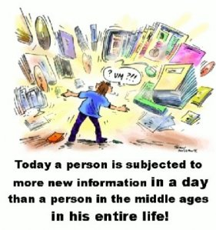
Information Overload

Slide 4
State of Digital Universe
During last ten years the volume and diversity of digital information grew at unprecedented rates.
Amount of information is doubling every 18 months, and unstructured information volumes grow six times faster than structured.

Slide 5
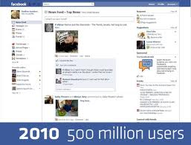
250 million
new people
on Facebook
last year
800 million total

Slide 6
30 billion
pieces of content
shared on
Facebook
every month

Slide 7
100 million
new accounts on Twitter in 2010
200 million total

Slide 8
25 billion tweets
sent on
Twitter in 2010
Now over
250 million
tweets sent daily

Slide 9
And a lot of other social media sites:
Blogs, microblogs, wikis,
social bookmarking,
curated news, etc.

Slide 10
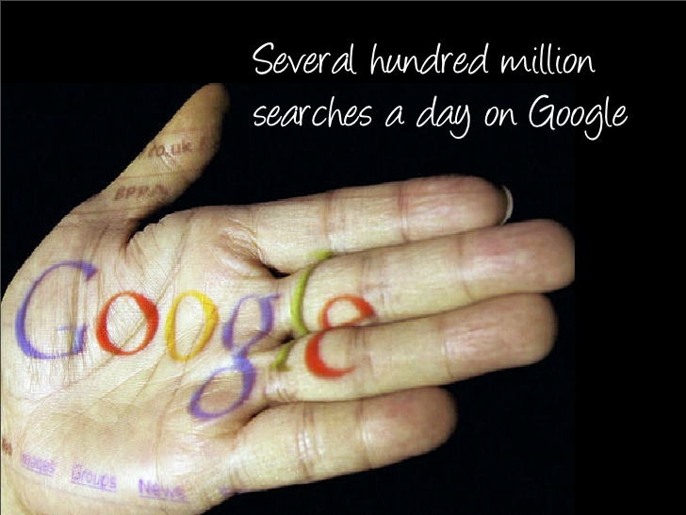

Slide 11
By 2011, the digital universe was
10X
as big as it was in 2006
In 2011, the amount of digital information created in the World has exceeded 1zettabyte –
it was 1.2 zettabyte =
a stack of DVDs stretching to the moon and back
What is an zettabyte?
One trillion gigabytes

Slide 12
The amount of digital information is doubling every
18 months
In 10 years there will be as many bits of digital universe as there are stars in physical universe
2020: 35 zettabytes
(35 trillion gigabytes) =
a stack of DVDs reaching halfway to Mars
The growth of data continues to outpace available storage capacity

Slide 13
Future Trend – Big Data
Big data - data sets whose size is beyond the ability of commonly used software tools to capture, manage, and process the data within a tolerable elapsed time.
Challenges:
capture
storage
search
sharing
analysis
visualization

Slide 14
About 30 % of the total volume of information in the Digital Universe is created by businesses and organizations
… and most of it is unmanaged.

Slide 16
Most of which is stored
haphazardly on a variety of
servers and drives
and… even filing cabinets!
And it is getting worse…

Slide 17
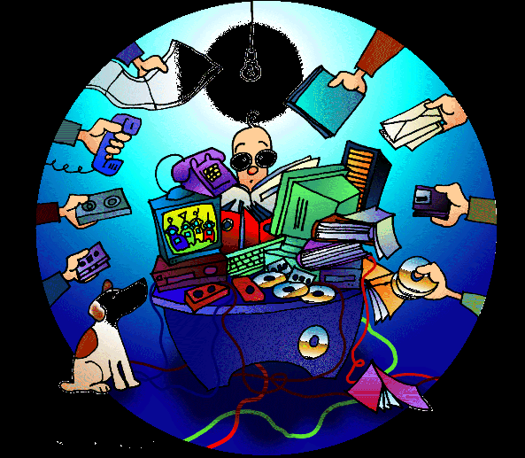
There is an increased use of:
departmental network drives
collaboration tools
content management systems
messaging systems with file attachments
corporate blogs and wikis
databases

Slide 18
There are duplicate and untraceable documents that crowd valuable information needed to get work done.
Employees spend too much time, about 20% of their time, on average, looking for, not finding and recreating information.
Once they find the information, 42% of employees report having used the wrong information, according to a recent survey.

Slide 19
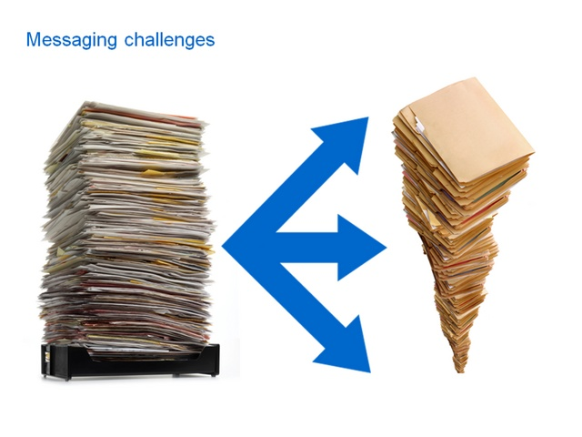
Think about email…
Only 13% of organizations have
deployed an email management
strategy across their organization.
56% of organizations have no
policy at all relative to e-mail retention.

Slide 20
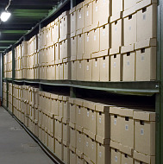
Many organizations do not understand the
difference between archiving and back-up.
According to AIIM survey, 59% think that email is “archived” as part of back up or PST files.
That amounts to little more than an
e-mail digital landfill !

Slide 21
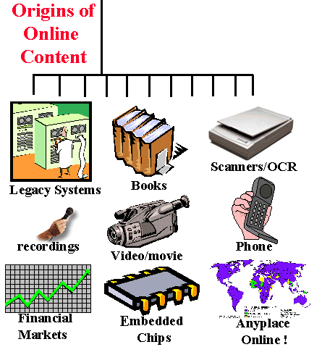
Think about other kinds of electronic information…
…many organizations have not
begun to address the core
process of managing electronic
information...
…most organizations likely have core systems to manage
MONEY and PEOPLE ...
…but what about INFORMATION?

Slide 22
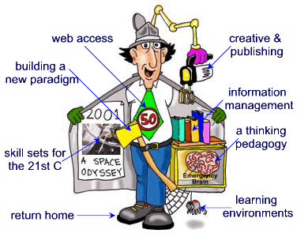
Over 40% of organizations have no policy for classifying electronic information as business records.
Nearly 64% of users believe that their organization understands what PAPER records are and how they should be retained.
Only 34% have the same understanding when considering
ELECTRONIC records.
This means that most ELECTRONIC INFORMATION winds up in the digital landfill !

Slide 23
Think about legal exposure…
Only 41% of organizations deliver any sort of training on how to handle electronic information.
That means the CEO is going to
have an awful hard time in court explaining his/her digital landfill.

Slide 24
Think about process inefficiency…
On a scale of 1 (terrible) to 10 (excellent) how would you rate the effectiveness of your organization in managing information?
54% would give themselves a grade of 5 or less.

Slide 25
52% of organizations have
“little or no confidence”
that their electronic information is accurate, accessible, and
trustworthy.
…and yet over 90% of
organizations view their ability
to manage electronic
information as critical to their
future.
That means that most organizations
are pretending the digital
landfill does NOT exist.

Slide 26
Solution = Information Management
The information Superhighway

Slide 27
The true value of information is not its immediate use.
The value of information depends on two things: finding it, and being able to use it.
In order to effectively use information, it must be readily available for analysis and synthesis with other information.

Slide 28
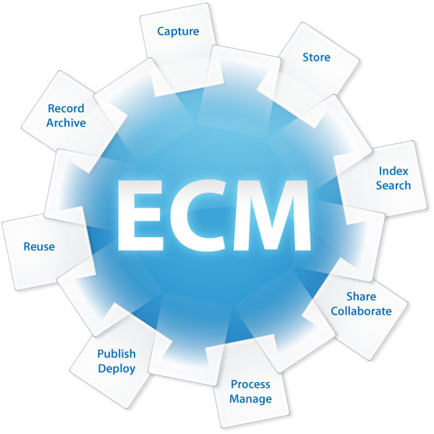
Content Management
Enterprise Content Management (ECM) is the set of strategies, methods, and tools used to capture, manage, store, preserve, and deliver content.
These strategies, methods, and tools allow managing content through its lifecycle from its creation, review, storage, and dissemination to destruction.
Main goals are accessibility,
findability, and re-use of content.

Slide 29
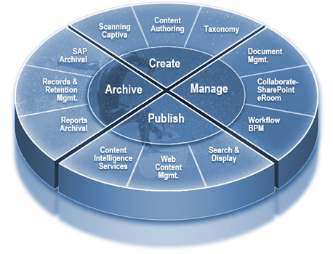
Why Content Management?
There are few reasons to manage content:
Central documents repository
Enable collaboration
Eliminate paper records
Automate processes
Protect sensitive information
Improve control of information
Increase efficiency and productivity
Reduce cost
Improve legal and regulatory compliance
Be able to search for documents, images, assets

Slide 30
Litigation, regulatory compliance, external and internal audits are becoming increasingly important.
Content tends to be distributed far and wide…
and it could be misfiled or retained longer than required…
A single business record can become a great liability in a litigation or a compliance audit.

Slide 31
Return on Investment
1 employee = $100/hour
1 employee = 1 hour a day for information search
= 0 efficiency and productivity = $100 loss
100 employees = 1 hour a day for information search = 0 efficiency and productivity = $10,000 loss
100 employees = 1 year for information search
(260 working days) = $ 26,000,000 lost.
Legal Discovery or Compliance Audit +
Lack of Documents = Disaster
The cost of a content management solution = $500,000 – 1,500,000 – one time expense (commercial CMS)
$0 CMS cost – open source CMS

Slide 32
Few Questions to Consider
How many digital landfills are there in your organization?
Is the explosion of digital information making your organization more effective or
less effective?
Can your employees find the information they need when they need it?
Can your employees collaborate on projects no matter where they are located in the world?

Slide 33
Help is available!

Slide 34
Galaxy Consulting provides consulting services in:
Content and knowledge management
Records management
Information architecture
Enterprise search
Document control
Taxonomy and metadata development and management
Information governance
Business analysis and usability

Slide 35
Eleonora Babayants
Email: eleonora@galaxyconsulting.net Office: 650-474-0955
Mobile: 650-716-3609
www.galaxyconsulting.net
Twitter: GalaxyConsult
Facebook: Facebook.com/GalaxyConsult

