Slide 1
Documents Management
Eleonora Babayants
Galaxy Consulting

Slide 2
Information - Strategic Asset
Information - strategic asset of a company: intellectual property, product roadmaps, manufacturing plans, etc.
The true value of information is not its immediate use.
The value of information depends on two things: finding it and being able to use it.
It must be readily available for analysis and synthesis with other information.
Information drives a company – development of new drugs, process improvement, innovation, expansion into new regions, cost savings, etc.
Pharmaceutical companies - subject to strict compliance regulations.
Document control is the cornerstone of quality assurance system and compliance.

Slide 3
GxP/GMP and Document Control
GxP/GMP - “A manufacturer shall establish and maintain procedures to control all documents”.
Document Control Procedures:
Documents approval and distribution
Documents changes
Document Control Steps:
Creation
Revising
Routing
Approval
Distribution
Archiving

Slide 4
GxP/GMP and IT
GxP/GMP – “All documentation must be issued, managed and controlled using a document management system.”
Requirements:
Validation
Security certification, secure login
Auditing
Keeping archives
Accountability
Non-repudiation
Change control

Slide 5
Proliferation of Content

Slide 6
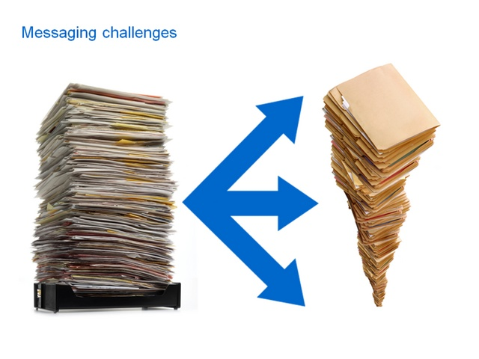
Proliferation of Content
Content is stored
haphazardly on a variety of
servers and drives
and… even filing cabinets!
And think about email – do you have a policy on email retention or an email management strategy?

Slide 7
Proliferation of Content
There is an increased use of:
departmental network drives
collaboration tools
content management systems
email with file attachments
corporate blogs and wikis
databases

Slide 8
Legal Exposure
Litigation, regulatory compliance, external and internal audits are important to remember.
Content tends to be distributed far and wide and it could be misfiled or retained longer than required.
A single business record can become a great liability in a litigation or a compliance audit.

Slide 9
Process Inefficiency
There are duplicate and untraceable documents that crowd valuable information needed to get work done.
Employees spend too much time, about 20% of their time, on average, looking for, not finding and recreating information.
Once they find the information, 42% of employees use the wrong information.
Result - loss of efficiency, productivity, high labor cost.

Slide 10
Social Computing
Tools: blogs, instant messaging, wikis, social
tagging and bookmarking, discussion boards
with comments fields, etc.
Two-edged sword: knowledge sharing and noise, volume and diversity of information.
Before: how much do you want to connect vs how much do you want to collect?
Now: how much do you want to curate vs not curate?
May impact ability to manage risk.
Increase information control and visibility.
Understand, develop policies and solutions to stay compliant.

Slide 11
Mobile Computing
Ability to access content from mobile devices.
Content and systems must be optimized for mobile devices.
Employees working in the field must be able to access content from their mobile devices.
Employees use mobile devices to collaborate on documents, take meeting notes, create presentations, and collect data in the field.
Decide what content and services make the most sense for mobile devices.
Security of mobile content.
Compliance requirements for mobile content.

Slide 12
“Bring Your Own Device” (BYOD)
Employees bring iPads, iPhones, Androids, Blackberrys to work.
Benefit – cost savings to IT.
Challenges:
Security, workflow, management issues for IT.
Employees own devices, but they don’t own the corporate data.
Corporate data in the consumer-based public cloud – cloud operator owns the data.
Hackers - accessing corporate data.
Define and control levels of access BYOD has to a company networks, applications, and data.
Establish a comprehensive governance policy.

Slide 13
Security
Example: a new drug, not yet under patent protection, and an employee takes that information to a competitor.
Example: information related to future revenue becomes disclosed.
Protect sensitive information - product roadmaps, manufacturing plans, vendor supply lists, marketing and promotional strategies, etc.
Set of policies, procedures, processes, roles, metrics, and controls allowing information to be securely and properly shared across departments, geographic locations, and systems.
Support of regulatory, legal, risk, and operational requirements.

Slide 14
Crisis Management
Crisis Situations:
Availability – illness, weather, turnover, fire, flood, severe weather, facility issues.
Technology – phone cut-off, system outage, applications are down, network problems.
Volume/Capacity – huge number of calls (in the example of a call center).
Special situations – pandemic, loss of facility, tornado, earthquake, etc.
Procedures for unplanned situation that would prevent a company from doing critical functions.
Procedures to ensure that needed documents are available when needed, content restoration.
Disaster recovery.

Slide 15
E-Discovery
Cost - to retrieve documents from servers, archives, backup tapes, etc. in case of a discovery order.
Cost - inability to execute a discovery order, to locate all documents in a timely manner, to place holds on all documents.
Ability to respond to legal requests, to solve litigation issues, mitigate the risk of sanctions, reduce impact and cost associated with litigation.
Avoid substantial discovery costs and discovery that disrupts normal business functions.
Ensure that documents are managed, retained, and can be quickly found and produced when it is required to do so in audits, investigations, and litigation.

Slide 16
Collaboration and New Employees Onboarding
Ability to collaborate effectively – need tools and processes.
Ability to share documents and coordinate projects among a group of people.
Ability to have a real time access to relative and current documents at any time irrespective of a location.
New employees need to have an access to relevant documents so that they could come to speed quickly and efficiently.
Time new employees waste being lost on pondering how to find documents is money a company is wasting by paying them to be at work without getting work done.

Slide 17
Manual Processes
Manual approval or review of documents – loss of efficiency and productivity.
Great liability - inability to prove documents approval from the right people.
Develop formal documents approval and review processes.
Enable the automation of documents moving through a sequence of tasks.
Streamline the required cost and time to coordinate common business processes.
Concentrate on performing your work instead of managing the logistics of the documents approval and review processes.
Meet regulatory and legal requirements.

Slide 18
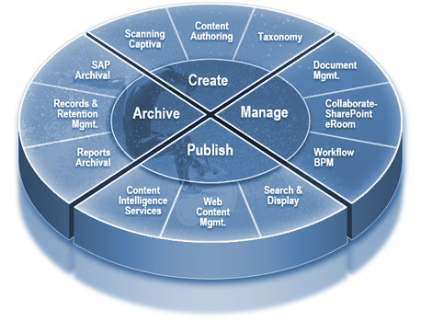
Why Documents Management?
Maintain legal and regulatory compliance.
Find documents quickly and easily.
Eliminate paper records.
Have greater control of information assets.
Maximize collaboration and innovation.
Streamline new employees onboarding.
Automate processes.
Protect sensitive information.
Increase efficiency and productivity.
Reduce cost.

Slide 19
Few Questions to Consider
Would your company pass an FDA audit?
If your company had a discovery order, would the process you use to manage documents stand up to scrutiny?
Has your ability to find documents got worse in the last few years?
Can your employees find the information they need when they need it?
Are your company’s processes running as smoothly as they should?
Have your company protected all sensitive documents?

Slide 20
Help is available!

Slide 21
Galaxy Consulting Services
Galaxy Consulting provides services in:
Document control
Content and knowledge management
Records management
Information architecture
Enterprise search
Taxonomy & metadata development and management
Information governance
Business analysis and usability
Call us today to schedule your free consultation
at 650-474-0955 or visit us at www.galaxyconsulting.net

Slide 22
Eleonora Babayants - President
Email: eleonora@galaxyconsulting.net Office: 650-474-0955
Mobile: 650-716-3609
www.galaxyconsulting.net
Twitter: GalaxyConsult
Facebook: Facebook.com/GalaxyConsult

